Slide 1


Intelligent system
Emotional Recognition
Daussaint Romain
Honnay Lucas
Industrial Engineer – Master 1
Academic Year 2020-2021

Slide 2
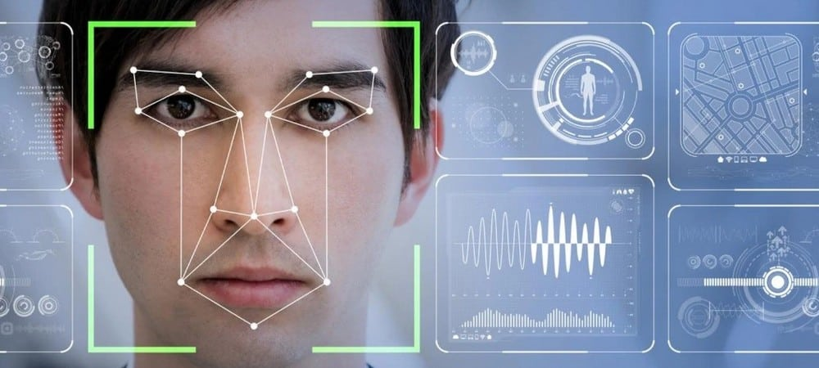
Intelligent system
Introduction
Emotional state can be detected from facial expression
How do we detect emotions in an image?
It’s the question of our project !
Introduction – Description of the project – Process – Planning – State of art – Conclusion

Slide 3


Intelligent system
Description of the Project
Happy
PC Webcam
Deep learning
Interface with related
emotion
Introduction – Description of the project – Process – Planning – State of art – Conclusion

Slide 4
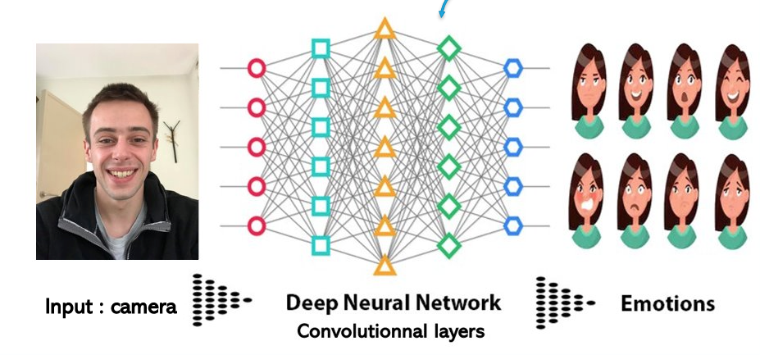
Intelligent system
Explication of the process
Use of CNN
Introduction – Description of the project – Process – Planning – State of art – Conclusion

Slide 5
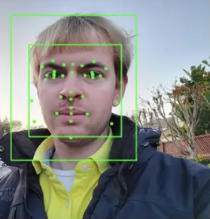
Intelligent system
Explication of the process
Parts of the face use:
Corner of the lips
Mouth
Cheeks
Eyes
Eyebrows
Wrinkles
Nose
Introduction – Description of the project – Process – Planning – State of art – Conclusion

Slide 6
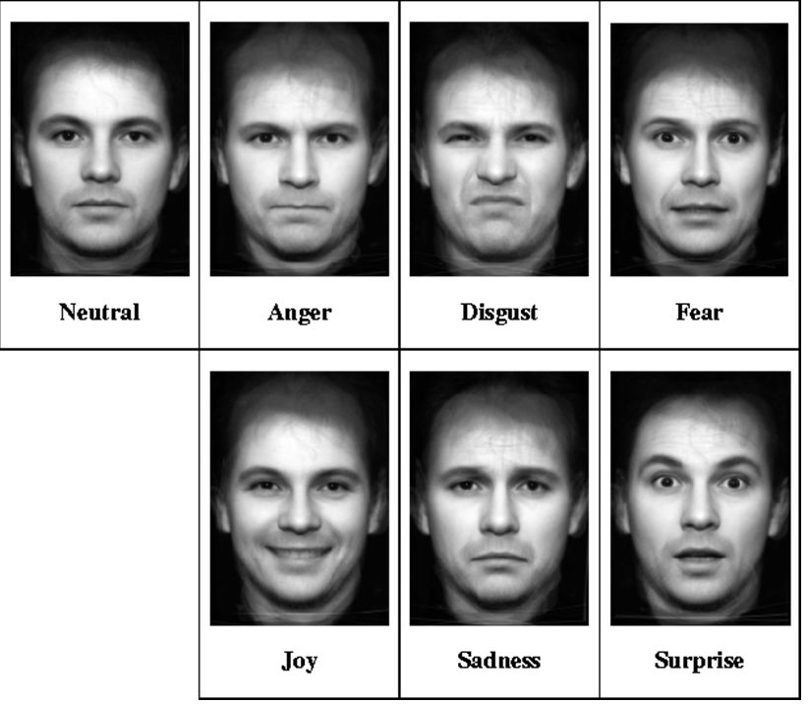
Intelligent system
Explication of the process
Output :
We would like to detect 7 emotions :
Introduction – Description of the project – Process – Planning – State of art – Conclusion

Slide 7
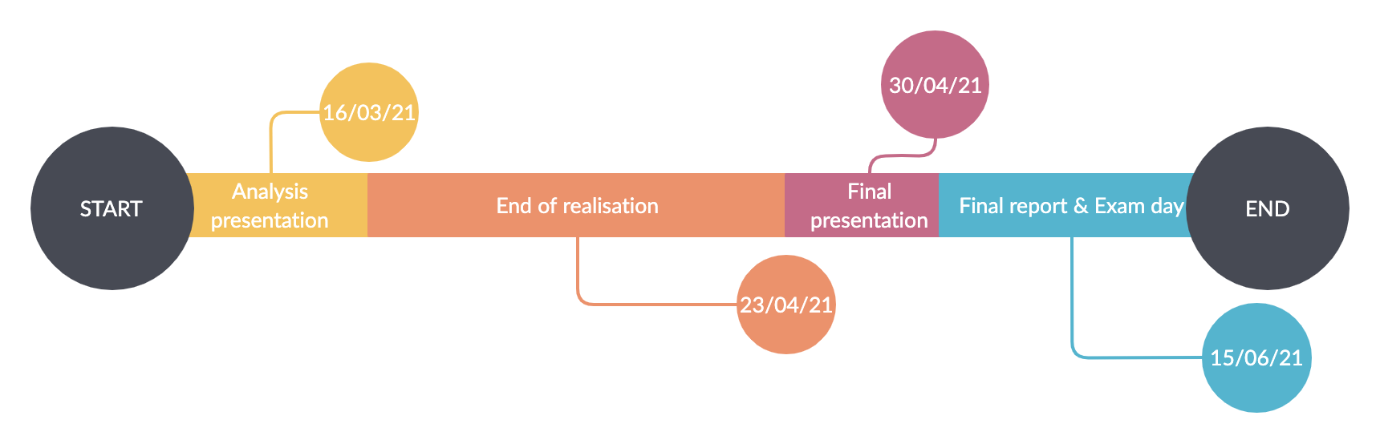
Intelligent system
Planning
Gantt Diagram
Introduction – Description of the project – Process – Planning – State of art – Conclusion

Slide 8
Intelligent system
State of art
1°Hight Dimensionnal Data CNN (PDF)
2° TFE about emotion recognition
https://tel.archives-ouvertes.fr/tel-01622639/document
3° Presentation on how the system works for the emotion recognition:
https://towardsdatascience.com/face-detection-recognition-and-emotion-detection-in-8-lines-of-code-b2ce32d4d5de
4 °Forum Python
https://openclassrooms.com/forum/categorie/langage-python
5°Link for making Windows talk
https://penseeartificielle.fr/tp-reconnaissance-faciale/
Introduction – Description of the project – Process – Planning – State of art – Conclusion

Slide 9
Intelligent system
State of art
Code
https://github.com/priya-dwivedi/face_and_emotion_detection/blob/master/src/EmotionDetector_v2.ipynb
Interface
https://vincent.developpez.com/cours-tutoriels/python/tkinter/apprendre-creer-interface-graphique-tkinter-python-3/#:~:text=Pour%20cr%C3%A9er%20une%20interface%20graphique,que%20des%20clics%20de%20souris.
https://www.youtube.com/watch?v=N4M4W7JPOL4
Introduction – Description of the project – Process – Planning – State of art – Conclusion

Slide 10

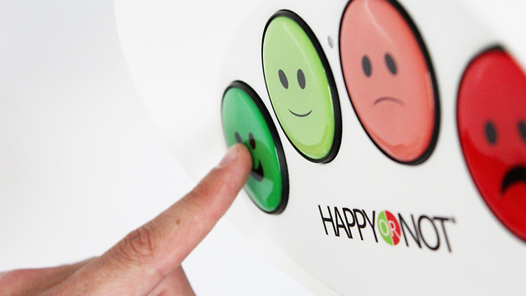



Intelligent system
Conclusion
Sectors using emotion recognition
Marketing
Education
Medecine
Security
HMI
Introduction – Description of the project – Process – Planning – State of art – Conclusion

Slide 11

Intelligent system
Any questions ?

